Slide 1

Object Oriented Programming-I
CS-322
Classes and Objects in C++
July 2020
Instructor: Bilal Jan

Slide 2

Outlines
What are classes and Objects
Object Oriented Approach
Constructor and its types
Passing objects as function arguments
Returning objects
Using one class objects in another class
Object as arrays
Example programs

Slide 3
Classes and Objects
Classes as user defined data types
Encapsulates data and functions
Data members as attributes of the class
Member functions as methods
Use and re-use by creating instances of the class object
Better access-control, management and hiding of data members and member functions
Memory allocation only at object creation

Slide 4
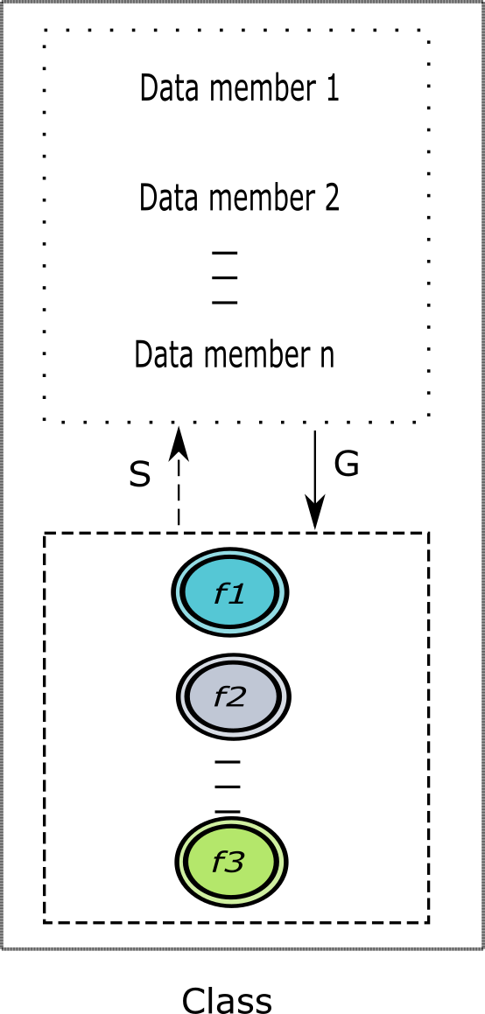

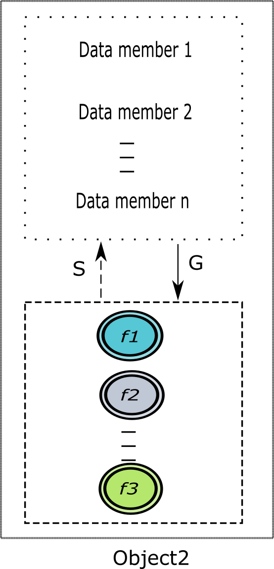
Classes and Objects

Slide 5
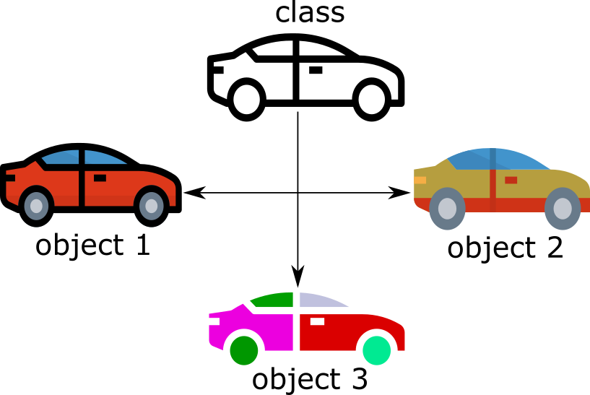
Example
Class Car with attributes as color, type, model, engine capacity etc.
Functions as drive & brake

Slide 6
Syntax of Class
class Name-of-class{
Access-Specifier:
data-members;
Access-Specifier:
member-functions;
};
Name-of-class object1,Object2,…;
Object.dataMember;
Object.memberFunction(arg1,arg2,…);
}

Slide 7
Example Car class
#include <iostream>
using namespace std;
class Car{
private:
string company,brandName,color;
double engineType;
int manufacturedYear;
public:
void setAll(string com,string brand,double eType,int year,string col){
company=com;
brandName=brand;
engineType=eType;
manufacturedYear=year;
color=col;
}

Slide 8
Example Car …
void print(){
cout<<"Printing specification details"<<endl;
cout<<"Manufacturer:\t"<<company<<endl;
cout<<"Brand:\t"<<brandName<<endl;
cout<<"Engine Capacity: "<<engineType<<"cc"<<endl;
cout<<"Year Manufactured: "<<manufacturedYear<<endl;
cout<<"Color:\t"<<color<<endl;
}
};
int main() {
cout<<"Creating three car types"<<endl;
Car sports,taxi,personal;
sports.setAll("BMW", "Alpina B6", 4.4, 2019, "Yellow");
sports.print();
return 0;
}
Creating three car types
Printing specification details
Manufacturer:BMW
Brand:Alpina B6
Engine Capacity: 4.4cc
Year Manufactured: 2019
Color:Yellow
BMW
4
A
19
Y
SetAll
print
T
X
1.8
15
W
SetAll
print

Slide 9
Objects implements members in its own way
BMW
Alpina B6
Toyota
xyz
4.4
2019
1.4
2015
Yellow
Red
SetAll
print
SetAll
print
SetAll
print

Slide 10
Constructors
Constructors are
Special member functions of a class used for
Initialization of data members
Auto calling for initial setup at object creation
Skeleton build-up
Special because of
Same name as class name
No return type
Called automatically when object of constructor type is created
Number, type and order of parameters delivers different constructor types e.g. no-arg constructor, one-arg constructor etc.
In absence of any constructor for a class, default constructor is called

Slide 11
Example Constructor
#include <iostream>
using namespace std;
class Employee{
private:
string name; double salary; int yearsWorked;
public:
Employee(){
name="";
salary=0.0;
yearsWorked=0;
}
Employee(int years){
name="";
salary=0.0;
yearsWorked=years;
}

Slide 12
Example Constructor
Employee(string fName,double sal,int years){
name=fName;
salary=sal;
yearsWorked=years;
}
void setName(string str){
name=str;
}
void setSalary(double sal){
salary=sal;
}
void setYearsWorked(int years){
yearsWorked=years;
}

Slide 13
Example Constructor
double getSalary(){
return salary;
}
void display(){
cout<<"Printing record of Employee"<<endl;
cout<<"Name:\t"<<name<<endl;
cout<<"Salary:\t"<<salary<<endl;
cout<<"Years worked:\t"<<yearsWorked<<endl;
}
};

Slide 14
Example Constructor
int main() {
Employee emp1;
emp1.display();
emp1.setName("Ali");
emp1.setSalary(10000);
emp1.setYearsWorked(3);
emp1.display();
Employee emp2(5);
emp2.display();
emp2.setSalary(1000);
emp2.display();
Employee emp3("Yousuf",5000,3);
emp3.display();
double totalSalary;
totalSalary=emp1.getSalary()+emp2.getSalary()+emp3.getSalary();
cout<<"Total Salary "<<totalSalary<<endl;
return 0;
}

Slide 15
Output
Printing record of Employee
Name:
Salary:0
Years worked:0
Printing record of Employee
Name:Ali
Salary:10000
Years worked:3
Printing record of Employee
Name:
Salary:0
Years worked:5
Printing record of Employee
Name:
Salary:1000
Years worked:5
Printing record of Employee
Name:Yousuf
Salary:5000
Years worked:3
Total Salary 16000

Slide 16
Objects as Function Arguments
Objects can be used as
Parameters and as arguments in function call
Return type of function
Pass by value and pass by reference
Return-type function-name ( class-name obj1, class-name obj2, … ){
}
int addMarks( Subject subj1, Subject subj2, Subject subj3){
int sumMarks;=0
sumMarks=subj1.getMarks()+subj2.getMarks()+subj3.getMarks();
return sumMarks;
}
Subject addMarks( Subject subj1, Subject subj2){
Subject temp;
temp.setMarks(subj1.getMarks()+subj2.getMarks() );
return temp;
}

Slide 17
Objects as Function Arguments
#include <iostream>
#include <string.h>
using namespace std;
class Subject{
private:
string subName;
int marks;
public:
Subject(){
subName="";
marks=0;
}
Subject(string name,int obtainedMarks){
subName=name;
marks=obtainedMarks;
}
void display(){
cout<<"Subject Name: "<<subName<<endl;
cout<<"Marks obtained: "<<marks<<endl;
}
void setName(string st){subName=st;}
void setMarks(int m){marks=m;}
string getName(){return subName;}
int getMarks(){ return marks;}
int addMarks(Subject s1, Subject s2){
int sumMarks=0;
sumMarks=s1.getMarks()+s2.getMarks();
return sumMarks;
}
Subject addMarks(Subject s1, Subject s2,Subject s3){
Subject temp;
temp.setMarks(s1.getMarks()+s2.getMarks()+s3.getMarks());
return temp;
}
};

Slide 18
Objects as Function Arguments
int main(){
Subject s1("Calculus-I",87);
Subject s2("Programming in C",75);
Subject s3;
s1.display();
s2.display();
s3.setMarks(s3.addMarks(s1, s2));
s3.setName("Numerical Libraries");
s3.display();
Subject s4;
s4=s4.addMarks(s1, s2,s3);
s4.setName("Applied Programming");
s4.display();
}
Output
Subject Name: Calculus-I
Marks obtained: 87
Subject Name: Programming in C
Marks obtained: 75
Subject Name: Numerical Libraries
Marks obtained: 162
Subject Name: Applied Programming
Marks obtained: 324

Slide 19
Objects re-use and intractability
Objects of one class can be used in another for
Re-use
Intractability
Modular design and better control

Slide 20
Program on objects interaction
#include <iostream>
#include <math.h>
using namespace std;
class Point{
private:
double x,y;
public:
Point(){ x=y=0.0;}
Point(double xc,double yc){ x=xc; y=yc;}
void setX(double xc){x=xc;}
double getX(){return x;}
void setY(double yc){y=yc;}
void setXY(){
cout<<"Point coorindates"<<endl;
cout<<"Enter X-cooridnate value"<<endl;
cin>>x;
cout<<"Enter Y-cooridnate value"<<endl;
cin>>y;
}
double getY(){ return y; }
void showPoint(){
cout<<"("<<x<<","<<y<<")";
}
};
class Distance{
private:
Point p1,p2;
public:
Distance(){ p1.setXY(); p2.setXY(); }
double getDistance(){
double eucDistance;
double diffX,diffY;
diffX=p2.getX()-p1.getX();
diffY=p2.getY()-p1.getY();
eucDistance=sqrt( pow(diffX,2)+pow(diffY,2) );
return eucDistance;
}
void display(){
p1.showPoint();
p2.showPoint();
}
};

Slide 21
Program on objects interaction…
Output
Point coorindates
Enter X-cooridnate value
2
Enter Y-cooridnate value
6
Point coorindates
Enter X-cooridnate value
3
Enter Y-cooridnate value
8
Points are
(2,6)(3,8)
Distance is 2.23607
int main(){
Distance d;
cout<<"Points are "<<endl;
d.display();
cout<<"\nDistance is "<< d.getDistance()<<endl;
}

Slide 22
Coming Up NEXT
Access specifiers and Inheritance

